Slide 1


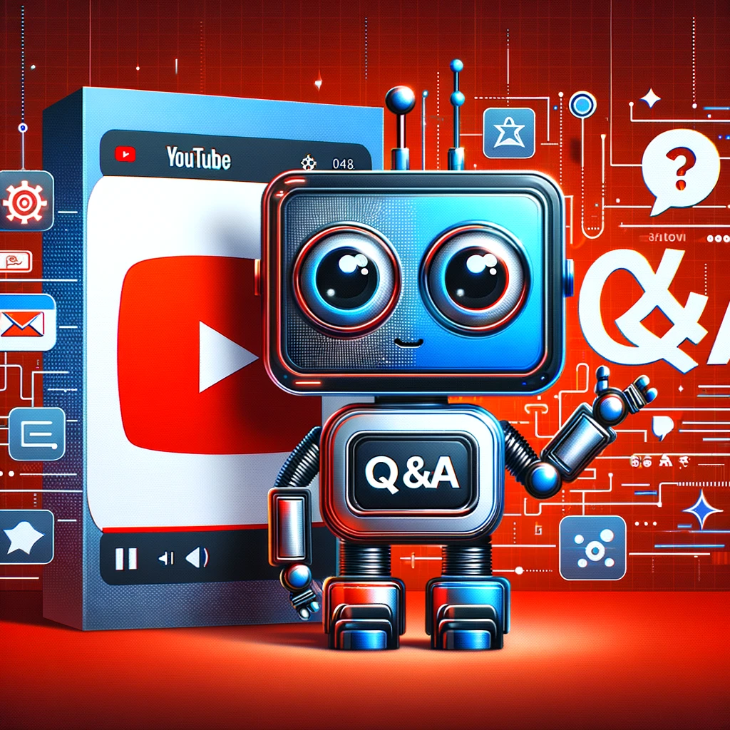
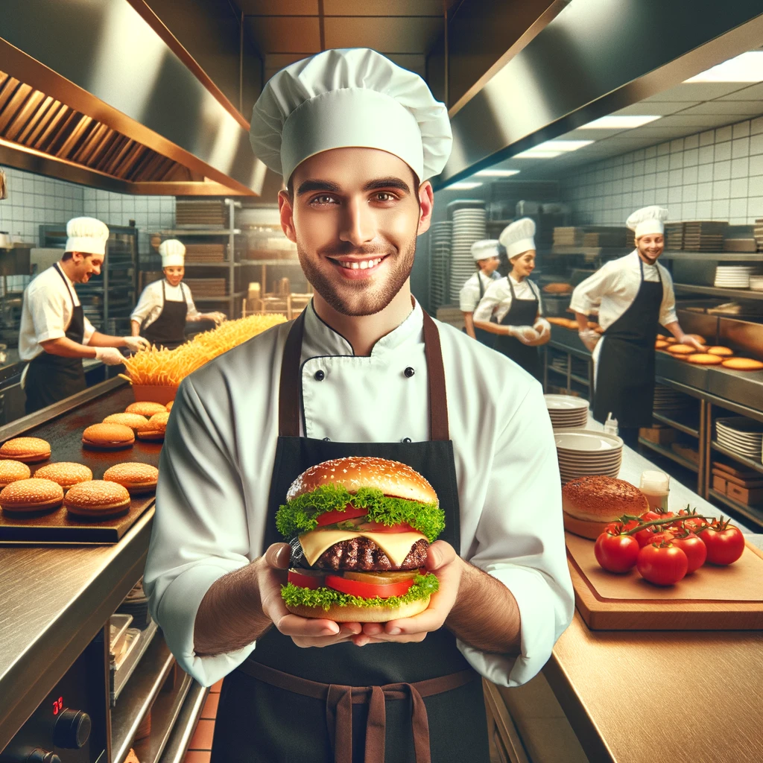
Youtube
π
The Generative AI Revolution: A Month-Long AI Exploration
Impact of Generative AI
YouTube Summarizer and Q&A bot
Business and Society
π
Week 2 Day 1: 9th Mar 2024

Slide 2
π
Agenda
Transcribe YouTube Video with LangChain Reference
Generate Video Summary
Question Answer from Video
Introduction to RAG
Burger Order Bot

Slide 3
π
Transcribe YouTube
Videos
with LangChain
Generate video summary
Question Answer from video
Notebook Reference: https://github.com/edquestofficial/Gen-AI-Cohort/blob/main/2024/march/3_Youtube_Transcript/Youtube_transcription.ipynb

Slide 4
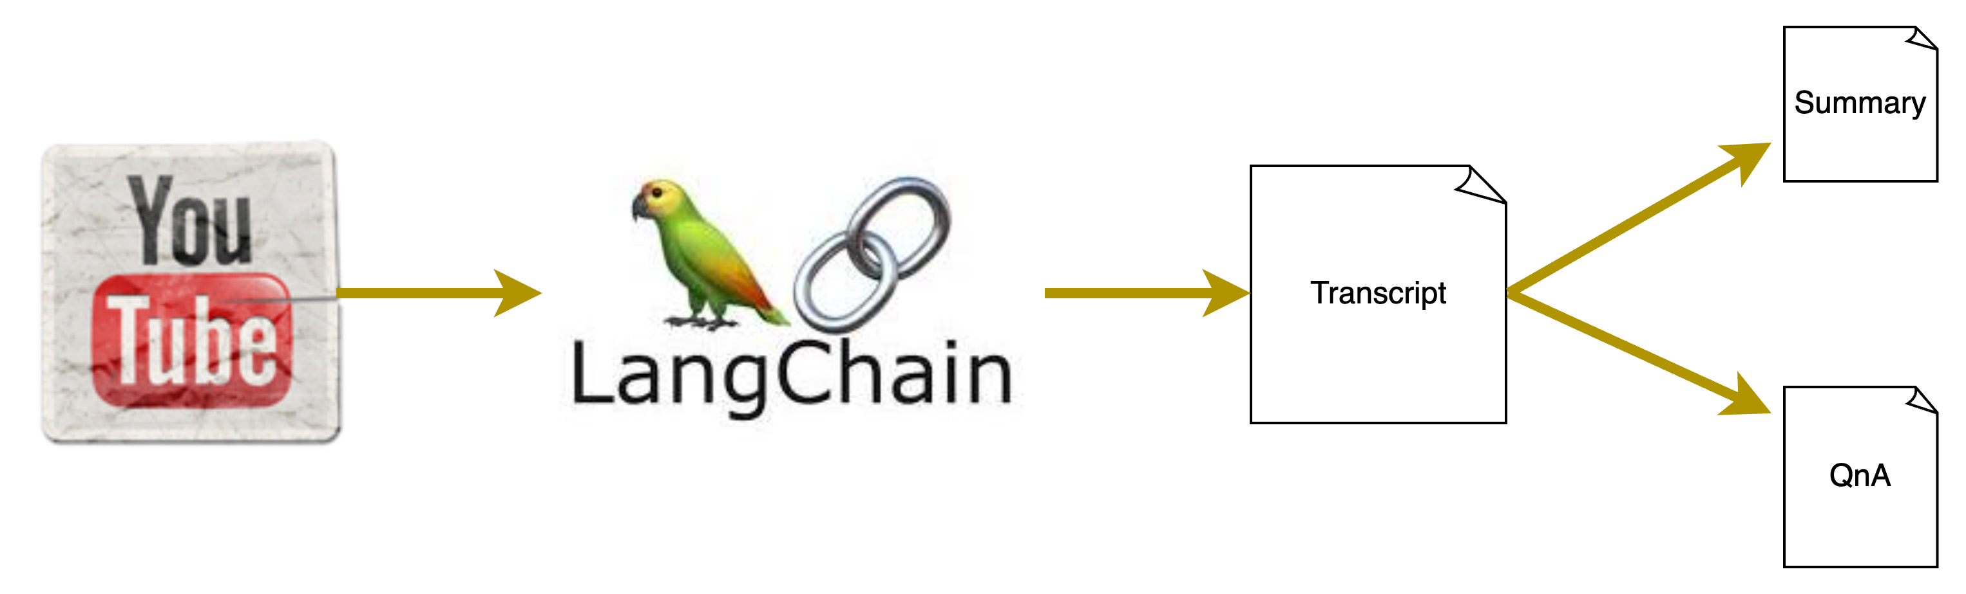
π
Transcribe YouTube Videos with LangChain
Generate video summary
Question Answer from video
Notebook Reference: https://github.com/edquestofficial/Gen-AI-Cohort/blob/main/2024/march/3_Youtube_Transcript/Youtube_transcription.ipynb

Slide 5
π
What is RAG
RAG stands for Retrieval-Augmented Generation. It is a technique used in generative AI to improve the quality and coherence of generated text.
RAG Models are typically composed of two components:
Retrieval module: This module retrieves relevant text passages from a large text corpus, such as Wikipedia or a specific domain-specific dataset.
Generation module: This module generates new text by conditioning on the retrieved text passages.

Slide 6




π
What is RAG
{
}
2
prompt
Search Relevant Information
Knowledge Source
3
Relevant
Context
1
prompt
LLM Endpoint
4
Prompt + Context
5
Generated Response
Retrieval Augmented Generation (RAG) Architecture

Slide 7
π
Burger Order Bot
Crafting a Chatbot with Gemini-pro LLM and Gradio UI
Notebook Reference: https://github.com/edquestofficial/Gen-AI-Cohort/blob/main/2024/march/4_Burger_Order_Bot/burger_order_bot.ipynb

Slide 8
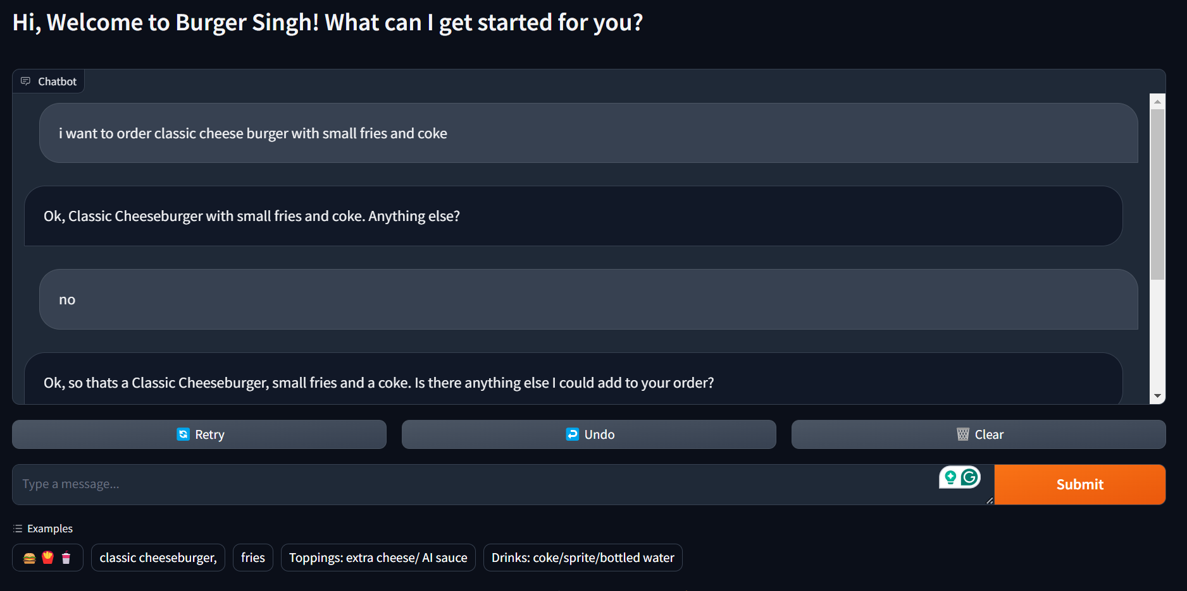
π
Burger Order Chatbot GUI

Slide 9
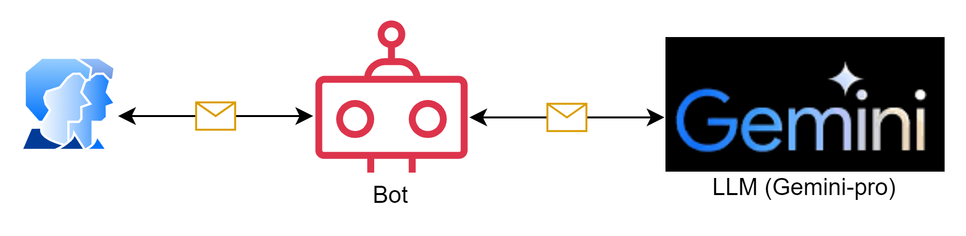
π
Burger Order Bot:
Implementing a Chatbot with Gemini-pro LLM
Utilizing Gradio for the User Interface
Notebook Reference: https://github.com/edquestofficial/Gen-AI-Cohort/blob/main/2024/march/4_Burger_Order_Bot/burger_order_bot.ipynb

Slide 10
π
Thank You!

